Slide 1
Is a 50% Reduction of Government Documents Space Possible? - The Curation Weeding Dance
Presented by: Agnes Zientarska-Kayko
Dana Porter Library

Slide 2
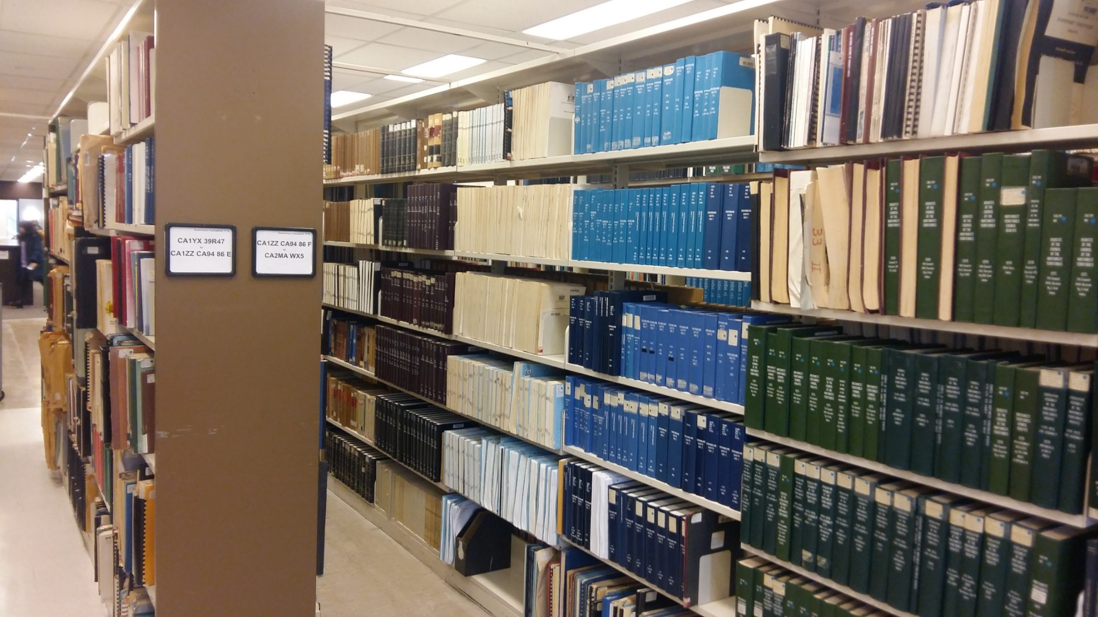
Agenda
Planning
Process
Conclusions / Lessons learned

Slide 3
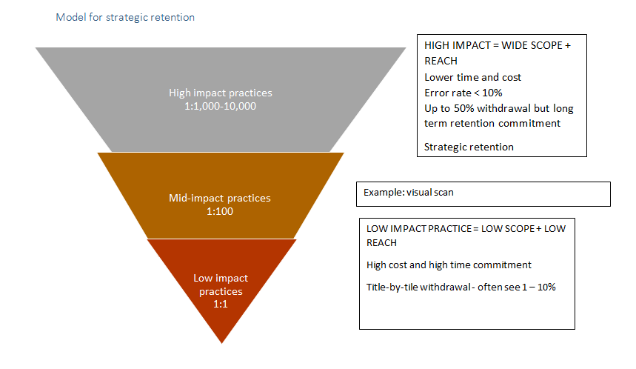
Planning
The story behind the project
University of Waterloo Library approach:
6000 or more linear feet of government documents
Needed to regain 3500 linear feet
Couldn’t afford time or resources to do title by title review

Slide 4
Planning
What does Strategic Retention mean?
Retain
Review (curate)
Withdraw

Slide 5
Planning - Strategic Retention Flow Chart
Strategic Retention
Known or easily identified
Retain long term
Relocate to review
Unknown - what we will come upon as we develop Strategic Retention Plan
Retain to digitize
Strategic
Gems (flag for appraisal)
LTR -Porter
LTR- On Campus (Davis basement)
LTR - Off campus
Withdraw
LTR- Porter
LTR - On campus
LTR - Off site
Retain long term
Withdraw
LTR - Porter
LTR - on campus
LTR - off site
Once digitized - withdraw

Slide 6
Planning - Strategic Retention Goals
Retain 50% of Government Documents collection
Commit to retain materials long term
Allow users easier access to our government documents by improving their discoverability
Retain, host, preserve and digitize strategic regional government documents

Slide 7
Planning
Collection Development Policy for Government Documents
Identify strategic retention areas
Transformational research themes
Campus priority research areas
Research Chairs focuses
Who on campus needs government documents?
Identify high level corporate authors whose publications in those areas we likely want to keep

Slide 8
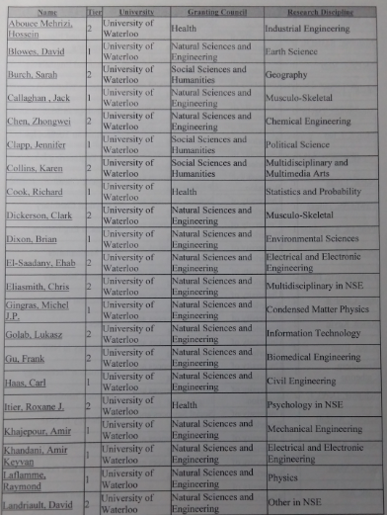
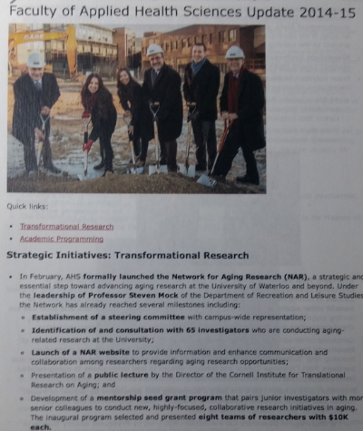
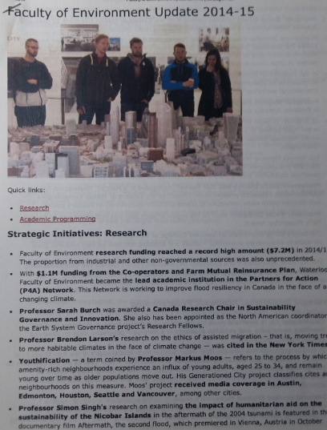
Planning

Slide 9
Planning
Criteria for retention, relocation or withdraw:
Relevance to curriculum, research and general collection
Historical value
Value of publication to community
What will not be kept by others

Slide 10
Planning
Break collection down into more manageable sections
Identify specific search terms within strategic retention areas
Tag specified concepts and search terms by list
Identify quick wins
Long runs
Visual inspection for monographs
Online availability

Slide 11
Planning

Slide 12
Planning

Slide 13
Process – Staff directly involved
Information Services and Resources – Manager, GP Librarian, Liaison Librarians (8), Contract Staff (6 months), Co-op Students (2)
Collection Management – Manager, Project Coordinator, Collection Maintenance Analyst , Contract staff (3), Student Staff (6)
Cataloguing – Dept. Head, Cataloguer, Co-op Student
Special Collections - Archivist

Slide 14
Process -Timeline
Winter - Spring 2016 – planning begins
Spring - Summer 2016 – consultations with librarians, tagging
Summer 2016 – pulling starts
Fall 2016 - Spring 2017 – pulling continues
July 3 2017 – packing of the floor starts
August 2018 – government docs are back in the library!

Slide 15
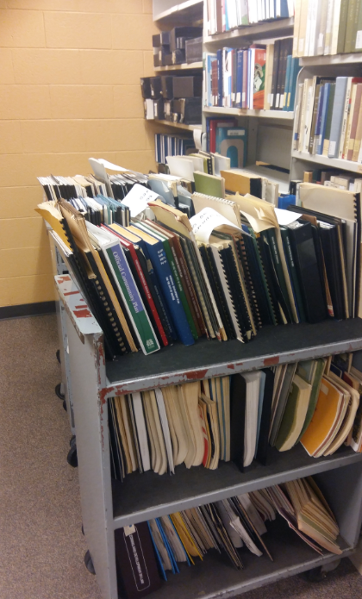
Process – Quick wins
International government documents (mix and match of content)
Visual Inspection Monograph Project
LC re-class and transfer books to the stacks
Discard
Long runs
Electronic access

Slide 16
Process – Working with lists
International (UK, UN, USA, EU)
Canada - Federal
Provinces
Ontario
Other Provinces
Region of Waterloo
Waterloo, Kitchener, Cambridge
Reference Collection

Slide 17
Process – Working with lists

Slide 18
Process
Items pulled using Withdraw Pull List
Discard temporary location assigned
Items not found on the shelf investigated
Global deletion process
Removing fines
Identifying records linked to orders
Updating records

Slide 19
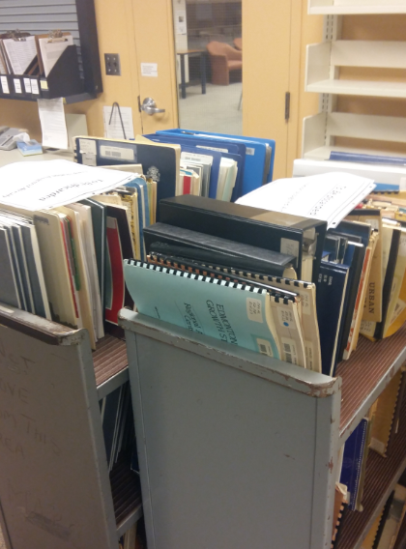
Conclusions /Lessons Learned
List of GP’s included:
145,926 – total number of items
74,729 – total number of bib records
70,002 – items withdrawn

Slide 20
Conclusions / Lessons learned
Communication with stakeholders
Collaboration across departments is a must
People will be upset
Be prepared to accommodate researchers requests

Slide 21
Conclusions / Lessons learned
“Fun” Facts
Missing documents
Government docs from other locations found
Documents already deleted from the catalogue found on the shelves
Problems with the list and call numbers sorting
Problems with tagging

Slide 22
Conclusions / Lessons learned
What worked?
Creating lists and sub lists for selectors to review (CA1, International, UK, UN, USA, EU, etc.)
Team work between three departments (ISR, Cataloguing, Circulation Maintenance)
GP Monograph Review and LC re-class
Search development work done by contract employee with cataloguing background

Slide 23
Conclusions / Lessons learned
What didn’t work?
Critical corporate authors
Necessary to ‘touch’ more materials than we expected
Longest run lists as first pass – other retention criteria needed to be applied first
TUG efforts to collaborate on deselection of materials

Slide 24
Government Documents Collection

Slide 25
Agnes Zientarska-Kayko
azientar@uwaterloo.ca

