Slide 1
Web archiving @ UTL: Gaps, traps & opportunities
Nich Worby,
University of Toronto Libraries
Government Information Day
Nov 30 2018

Slide 2
What we collect
Ontario Ministry sites (semiannually)
Ontario Government Agencies sites* (annually)
City of Toronto websites (semiannually)
Thematic collections – Political parties, labour unions
Event based collections – Elections, Pan Am Games, Summits
U of T institutional sites
& more
* Not crown foundations & only select operational enterprises using the definitions in the Agency Establishment and Accountability Directive
Image: robarts library by Andrew from the Noun Project

Slide 3
Why do we do it?
Extension of depository stewardship role in digital age
Addresses need for research material
Web archiving expertise

Slide 4
What we’re not … ¯\_(ツ)_/¯
A provincial archive
A comprehensive repository of every byte of gov web content
Compliant with records retention procedures
The only web archive

Slide 5
Where we fall down … ☹
Human resource limitations
Knowledge of the government web
Heads up on changes to government web
Avenues to address technical challenges
Forums to advocate for archiveability standards

Slide 6
Where we could use a hand … ☺
Collaborative seedlist development
Collaborative metadata creation
Support for quality assurance
Notification of major website changes
Shared voice in advocacy
Partners in addressing technical challenges
+
Image: ontario legislative building by Andrew from the Noun Project

Slide 7
Success!!
Ontario Provincial Election 2018 Collection
https://archive-it.org/collections/10004
Partnership between Ontario Legislative Library staff &
University of Toronto Libraries

Slide 8
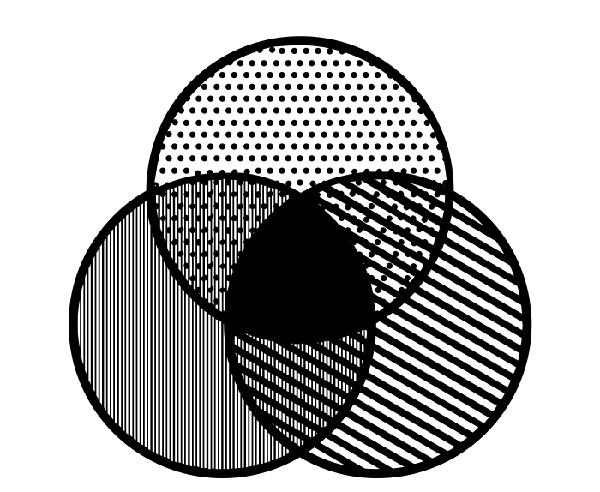
What might future collaborations look like?
Where is there low hanging fruit?
What are some common goals?
Let’s talk more!!
Canadian Web Archiving Coalition
http://www.carl-abrc.ca/advancing-research/digital-preservation/cwac/
Image: Venn Diagram by emilegraphics from the Noun Project

