Slide 1
Panel on Web Archiving Government Information: LAC’s Program Update
Government Information Day 2018
Tom J. Smyth
Manager, Digital Integration
Digital Preservation and Migration Division
tom.smyth@canada.ca
@smythbound

Slide 2
Five Main Web Archiving Activities
Domain crawl of the federal web presence
Curation of thematic and social media research collections
Reactionary, events-based collections
Preservation archiving of resources at risk (e.g., TBS WRI)
Acquisitions linked to existing library collections or archival fonds

Slide 3
Thematic Research Collections
Political Collections
142 seeds, including documenting cabinet shuffles and recurring collection of all federal political party websites
Collection of #cdnpoli and #canpoli using Twarc
Started ongoing collection on 29th January 2018
7.1+ million tweets collected, and about ~58 GB of data
Tweet capture rate: Over 700,000K per month (23,000+ per day)

Slide 4
Curation of Thematic Research Collections
Legalization of Cannabis in Canada
212 seeds, broad coverage of the media
Changes to legislation and frameworks (federal and provincial, includes bills and parliamentary and legislative assembly debates where possible)
Economic Impacts (job creation, expected revenue, black markets)
Health (public and mental health)
Advocacy (e.g., advocacy supporting small growers, legal pardons for previous possession offenders)
Business and retail (including provincial retail sites & corporate sites)
From 10-22nd October 2018, we collected 48k tweets from the #legalizationday hash via Twarc

Slide 5
Curation of Thematic Research Collections
First World War Commemoration
1000 seeds, with emphasis on regimental and soldier histories; commemoration activities; documenting major battles in which Canadians took part
From March to April 2017, we collected 122k tweets from the #vimy100 hash via Twarc
150th Anniversary of Canadian Confederation
1,640 seeds on the official themes of Diversity and Inclusion, Engaging and Inspiring Youth, Indigenous Reconciliation, and the Environment
From May to December 2017, we collected 7.87 million tweets from the #canada150 hash via Twarc

Slide 6
Curation of Thematic Research Collections (2)
National Inquiry into Missing and Murdered Indigenous Women and Girls
111 seeds, focusing on advocacy and resources addressing violence against Indigenous women; research and data (on the scope, nature, and underlying causes of the problem); commentary on the national inquiry itself
Official Publications Seedlist (ask me about it!)
124 seeds, all the critical documentation: Publications.gc.ca, PARL.gc.ca, all courts and their decisions, all PCO’s and TBS’ resources, Budget, Gazette, the GG, Elections, Officers of Parliament, Ombudspersons, Stats Can resources, Canada.ca – and a partridge in a pear tree
Seeking to delta crawl these seeds on a regular schedule

Slide 7
Preservation Web Archiving
Web Renewal ended in December 2017, but:
Specialized crawls of Canada.ca and its subdomains continue (they’re complicated)
16.5 terabytes of federal web content collected in TBS Web Renewal contexts since 2014
~2.5 terabytes of which was collected this fiscal
Delta crawls of domains still in *.gc.ca, looking at RSS feeds to capture updates
1,730 seeds / resources to date (362 this fiscal)

Slide 8
Full-Text Search is Coming!
Full-text search is running internally! (beta)
Search by:
Keyword (“Tom’s Federal Budget”)
Resource type (e.g., PDF)
By domain (e.g., publications.gc.ca)
Working on including date range, and when done search will be publicly launched
You’ll be able to search back to 2005!

Slide 9
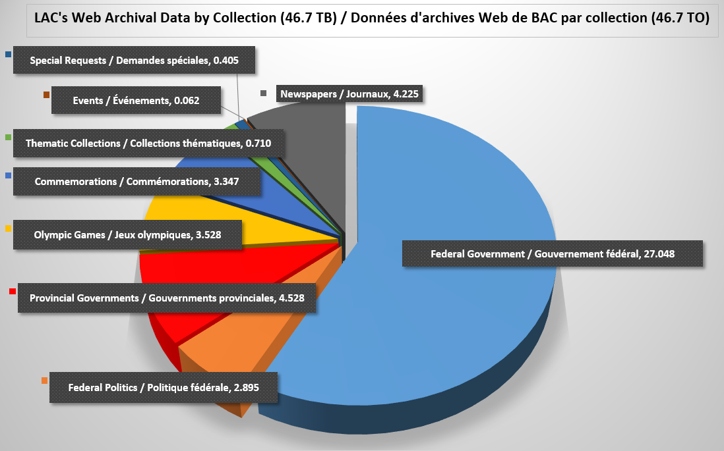
~48 TB of Web Archives since 2005

Slide 10
Web Archiving @ LAC
Tom J. Smyth
Manager, Digital Integration and Program Lead, Web Archiving
tom.smyth@canada.ca
@smythbound
Questions most welcome!

