Slide 1
Forensic Recovery of Evidence Device (FRED)
Allen Kwan

Slide 2
The Problem…

Slide 3
The Problem…

Slide 4
The Problem…

Slide 5
The Problem…

Slide 6
The Solution: FRED
Purpose-built computer for digital forensics.
Specifically a tool to copy files from a carrier of digital information securely and with no risk of modifying business (or archival) records.

Slide 7
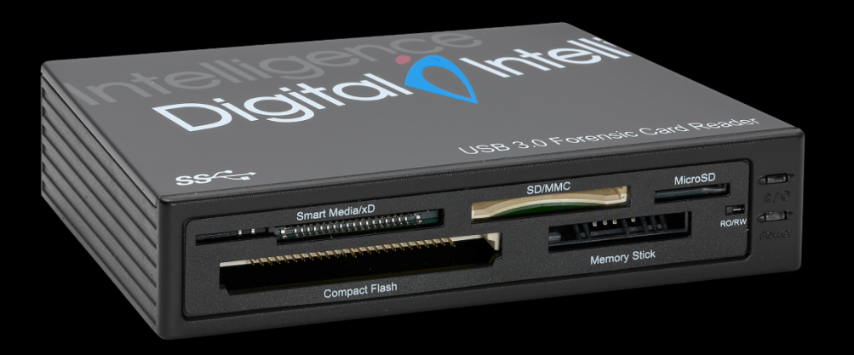
Write Blockers
FRED comes installed with Forensic Bridges or Write Blockers that allow for a wide variety of interfaces and prevent the user or operating system from modifying files on the carrier.

Slide 8
Floppy Disks
Other specialized hardware allows for access to 3.5”, 5.25” and even 8” floppy disks.
This hardware also serves as a write blocker, ensuring the safe handling of any files that exist on the disk.
Able to process Mac or Windows disks.

Slide 9
Software
Software allows you to make a copy of a disk/hard drive and analyze its content.
FTK Imager creates a 1-to-1 copy of the original disk called a forensic image.
BitCurator and Autopsy analyzes forensic images to produce reports on the types of files and potential personally identifiable information.

Slide 10
Putting it together into a Workflow
Archives of Ontario workflow developed by Blanche Joslin

Slide 11
Further Information
Allen Kwan
pmo.student@ontario.ca, allen.kwan@mail.utoronto.ca
recordkeeping@ontario.ca

