Slide 1
Government and Grey Literature Archiving Pilot: An Update
Ravit H. David, Scholars Portal, OCUL Univ. of Toronto
Graeme Campbell, Queen’s University
Government Information Day November 30 2018, Toronto ON

Slide 2
Project Background
In the spring of 2017, an OCUL-IR working group was formed to investigate the scope and suitability of current collections of government and grey literature, and to determine the feasibility of OCUL gathering, hosting, and providing access to its own collection of these materials using the Archive-It web archiving tool to support acquisition and Scholars Portal to support access and preservation.
As a result of the work of this group, OCUL-IR received New Initiatives funding for a home-grown, government and grey literature archiving & discovery pilot project. Two committees were formed in 2018 to carry out this work: a Steering Committee, and the Content Advisory Working Group.
Government Information Day November 30 2018, Toronto ON

Slide 3
Steering Committee
The Steering Committee speaks regularly with the Project Lead and the Content Coordinator to provide direction and feedback as the project progresses. They will also work with OCUL-IR and the Project Lead on the final evaluation of the pilot.
Jacqueline Whyte Appleby (Project Lead), Scholarly Resources Librarian, Scholars Portal
Janice Adlington, Collections Development Coordinator, McMaster University
Graeme Campbell, Open Government Librarian, Queen’s University
Simone O’Byrne, Information Specialist, Ontario Ministry of the Environment and Climate Change
Joanne Paterson, Head of Metadata Access, Western University
Government Information Day November 30 2018, Toronto ON

Slide 4
Steering Committee questions
How will we collect the documents?
What metadata is required for effective search and retrieval in Scholars Portal?
How do we navigate the complexities of copyright?
How can we leverage the work that is already being done by other groups who harvest and describe related collections?
What workflow(s) best address these concerns?
Who will do this work on an ongoing basis if we decide to continue?
Who are our key stakeholders?
Can these efforts help resolve additional collection issues? (e.g. Microlog)
How do we measure success?
Government Information Day November 30 2018, Toronto ON

Slide 5
Steering Committee paused since September 2018
Project Lead on leave for 10 months
Scholars Portal unlikely to have the resources to manage metadata creation and loading during this time
Members will be invited to return in the summer of 2019
Government Information Day November 30 2018, Toronto ON

Slide 6
Content Advisory Working Group
A subset of the OCUL Government Information Community, with additional ex-officio support from a government library colleague. This group works with the Content Coordinator to select pilot content to be harvested.
Ravit David (Content Coordinator), Ebook Coordinator and metadata librarian, Scholars Portal
Graeme Campbell, Open Government Librarian, Queen’s University
Sandra Craig, Metadata Services Supervisor, Legislative Assembly of Ontario
Rea Devakos, Project Officer, OCUL
Sylvie Lafortune, Social Sciences/Info Hub Project Librarian, Carleton University
Nicholas Worby, Government & Statistics Librarian, University of Toronto
Agnes Zientarska-Kayko, Information Services Librarian, University of Waterloo
Government Information Day November 30 2018, Toronto ON

Slide 7
What is already in Scholars Portal Books
National Round Table on the Environment and the Economy: 245 documents
Ontario Government Documents Collection: 28113 documents:
protected by Crown copyright
provided by the Ontario Legislative Library
Canadian Public Documents Collection: 55857 documents
The majority of SPB’s collection of government and grey literature
Restricted to subscribing institutions ($$)
Government Information Day November 30 2018, Toronto ON

Slide 8
Content Advisory Group: Two Fundamental Questions:
What to collect? How we decide on criteria and what should be the scope ? Do we collect for just in time use or for preservation?
2. Which technology to use for harvesting the digital objects for this collection? Archive It? If not, which other tools we need to look at and examine
Government Information Day November 30 2018, Toronto ON

Slide 9
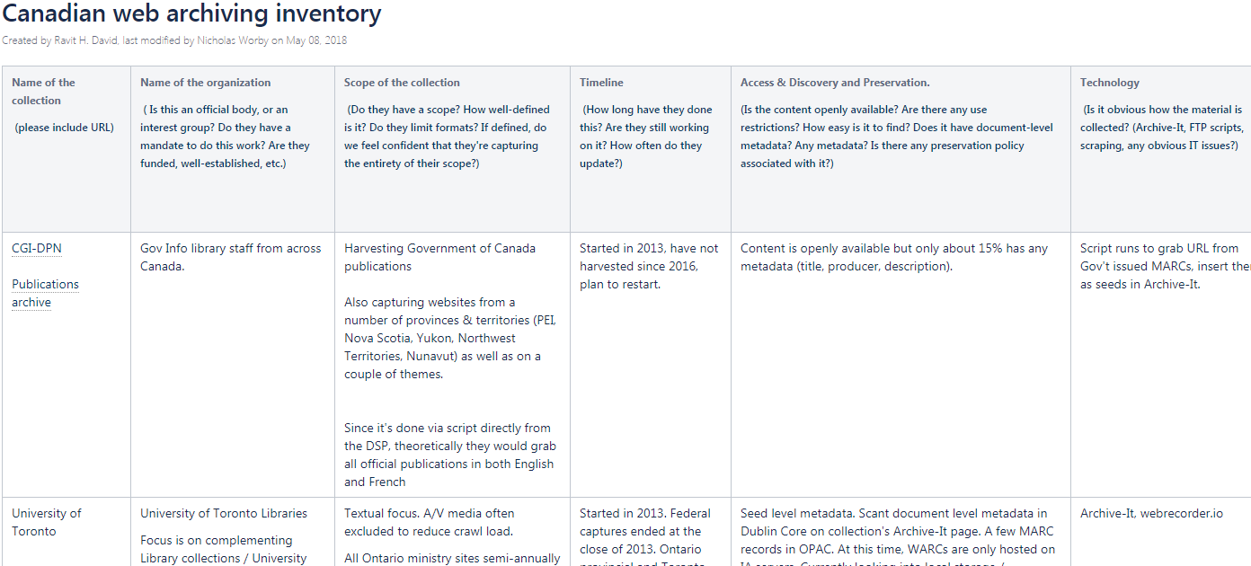
What to collect? a. Environmental scan
Government Information Day November 30 2018, Toronto ON

Slide 10
What to collect? b. What is being used on the Ebook platform?
For 55857 Canadian Public Documents Collection:
What are the top 100 titles (most used) for this collection?
For instance: Total distinct uses (2012-2017) for “Social determinants of health: the Canadian facts” was 1456
Can we identify some trends among the top 100? Is it mostly municipal, provincial, national content? What about “dead” sites?
Can we sort the publications by publisher name and look at usage per publisher?
For instance: Agriculture and Agri-Food Canada (between 2012-2017) in English and French - over 60 documents. Is it because so many were published, so many were collected? What was the criteria and whether it included the publisher
Government Information Day November 30 2018, Toronto ON
Notes:
Jurisdiction
Author
Publisher
Doc type
Keywords 1
Keywords 2
Keywords 3
National
Raphael, Dennis; York University (Toronto, Ont.). School of Health Policy and Management
York University School of Health Policy and Management
Grey
Public health
Medical policy
Public Health

Slide 11
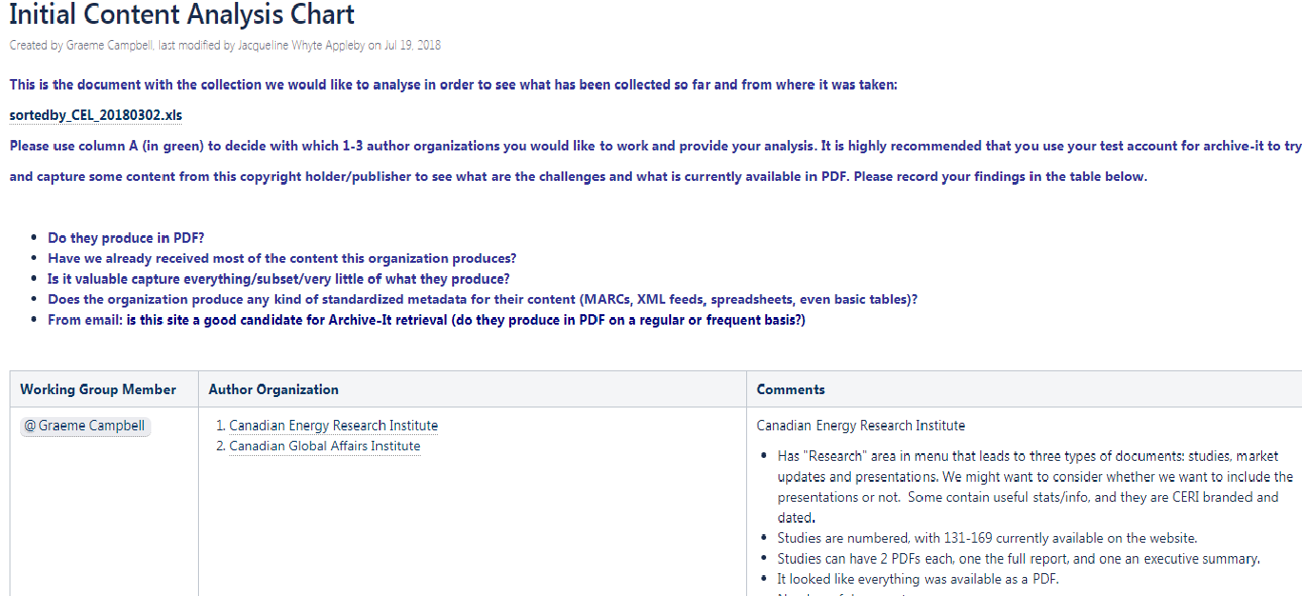
What to collect?
c. Content Analysis of single publishers from top 100
Government Information Day November 30 2018, Toronto ON

Slide 12
2. Which technology to use for harvesting the digital objects for this collection?
Members choose 5 organizations from the list of the “top 100” and try to use Archive-It in order to capture PDFs but also to evaluate if PDF is the main format or perhaps HTML
Consider other technologies for cases when PDF is not the main format used by the site/organization
Looking into the possibility of filling the gap for collections like Microlog that will be discontinued by ProQuest
Looking for other archiving technologies to test in the future
Government Information Day November 30 2018, Toronto ON

Slide 13
Thank you!
graeme.campbell@queensu.ca
ravit.david@utoronto.ca
Government Information Day November 30 2018, Toronto ON

