Slide 1
Origins, Current State and Future Enhancement

Slide 2
List of Every Problem Encountered while Searching for Government Publications…
www.gallopportal.ca

Slide 3
List of Every Problem Encountered while Searching for Government Publications…Just Kidding
www.gallopportal.ca

Slide 4
What is GALLOP?
The GALLOP Portal is intended as a one-stop access point to searchable electronic government documents collected by Legislative libraries in Canada for their jurisdictions.
www.gallopportal.ca

Slide 5
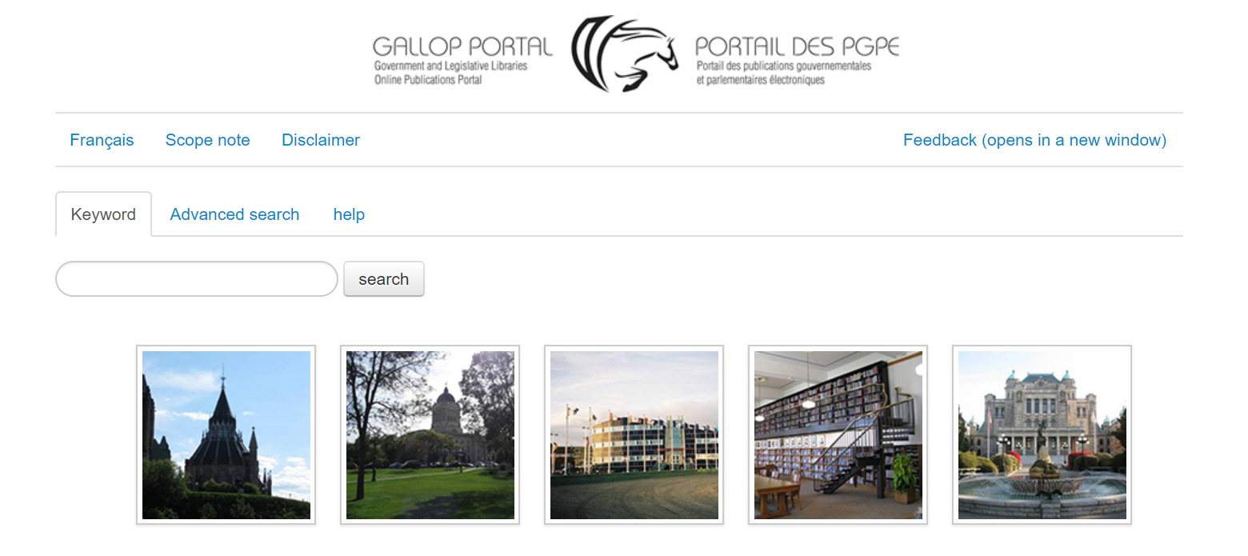
GALLOP Portal - Basic Search Page
www.gallopportal.ca

Slide 6
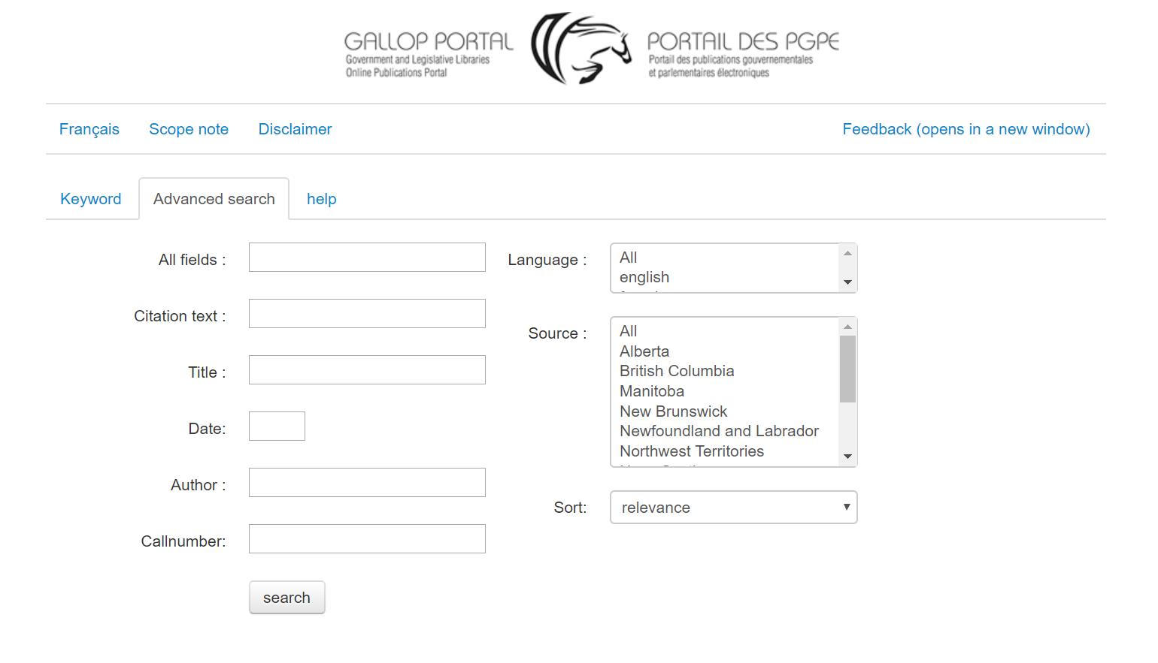
GALLOP Portal - Advanced Search Page
www.gallopportal.ca

Slide 7
Before GALLOP
www.gallopportal.ca

Slide 8
Start of GALLOP
Association of Parliamentary Libraries in Canada (APLIC) created a committee in mid-2008 to discuss ways of providing direct access to government publications catalogued by all jurisdictions
Development done using the strengths of employees across parliamentary libraries
GALLOP Portal released to the public in 2013
www.gallopportal.ca

Slide 9
Original Goals of GALLOP
Reduce duplication in collection activities
Enable easier pan-jurisdictional research
Make government publications more widely available
Contribute to national collection efforts
www.gallopportal.ca

Slide 10
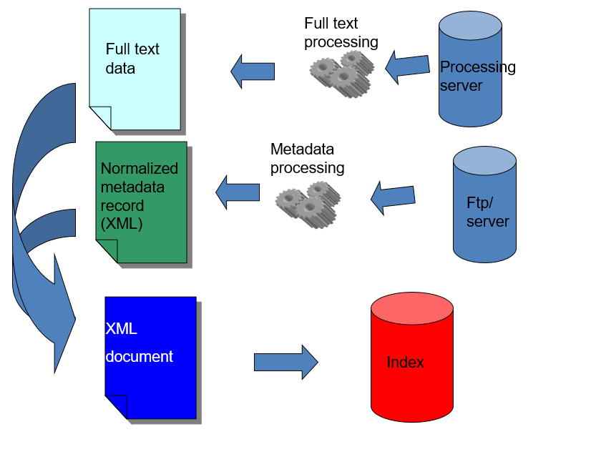
How GALLOP Works
Catalogue records submitted by legislative libraries
Records are normalized
Full text data is retrieved, made screen-readable (when possible) and added to the original record
Metadata and full-text are combined into an XML, which is indexed using SOLR
www.gallopportal.ca

Slide 11
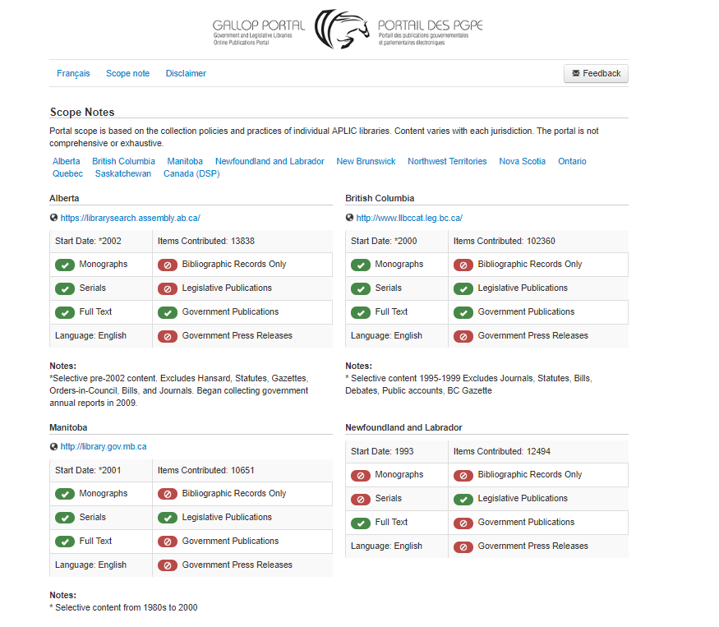
Scope of Documents Included in GALLOP
www.gallopportal.ca

Slide 12
Initial Success
www.gallopportal.ca

Slide 13
Revision, Review and Technical Difficulty Remediation
www.gallopportal.ca

Slide 14
The Future of GALLOP
www.gallopportal.ca

Slide 15
Recap
The GALLOP Portal is intended to enhance discovery of provincial, territorial and federal government publications
Parliamentary libraries across the country are working collaboratively to make it easier to discovery government publications
There is a commitment to update and improve the GALLOP Portal, and a desire to collaborate with other government information professionals
www.gallopportal.ca

Slide 16
We Want to Hear From You!
General Feedback Email - gallop@ola.org
David Cumming (me) - dcumming@ola.org
Julie Anderson, Manager of Content Management,
Legislative Assembly of Ontario- janderson@ola.org
www.gallopportal.ca

