Slide 1
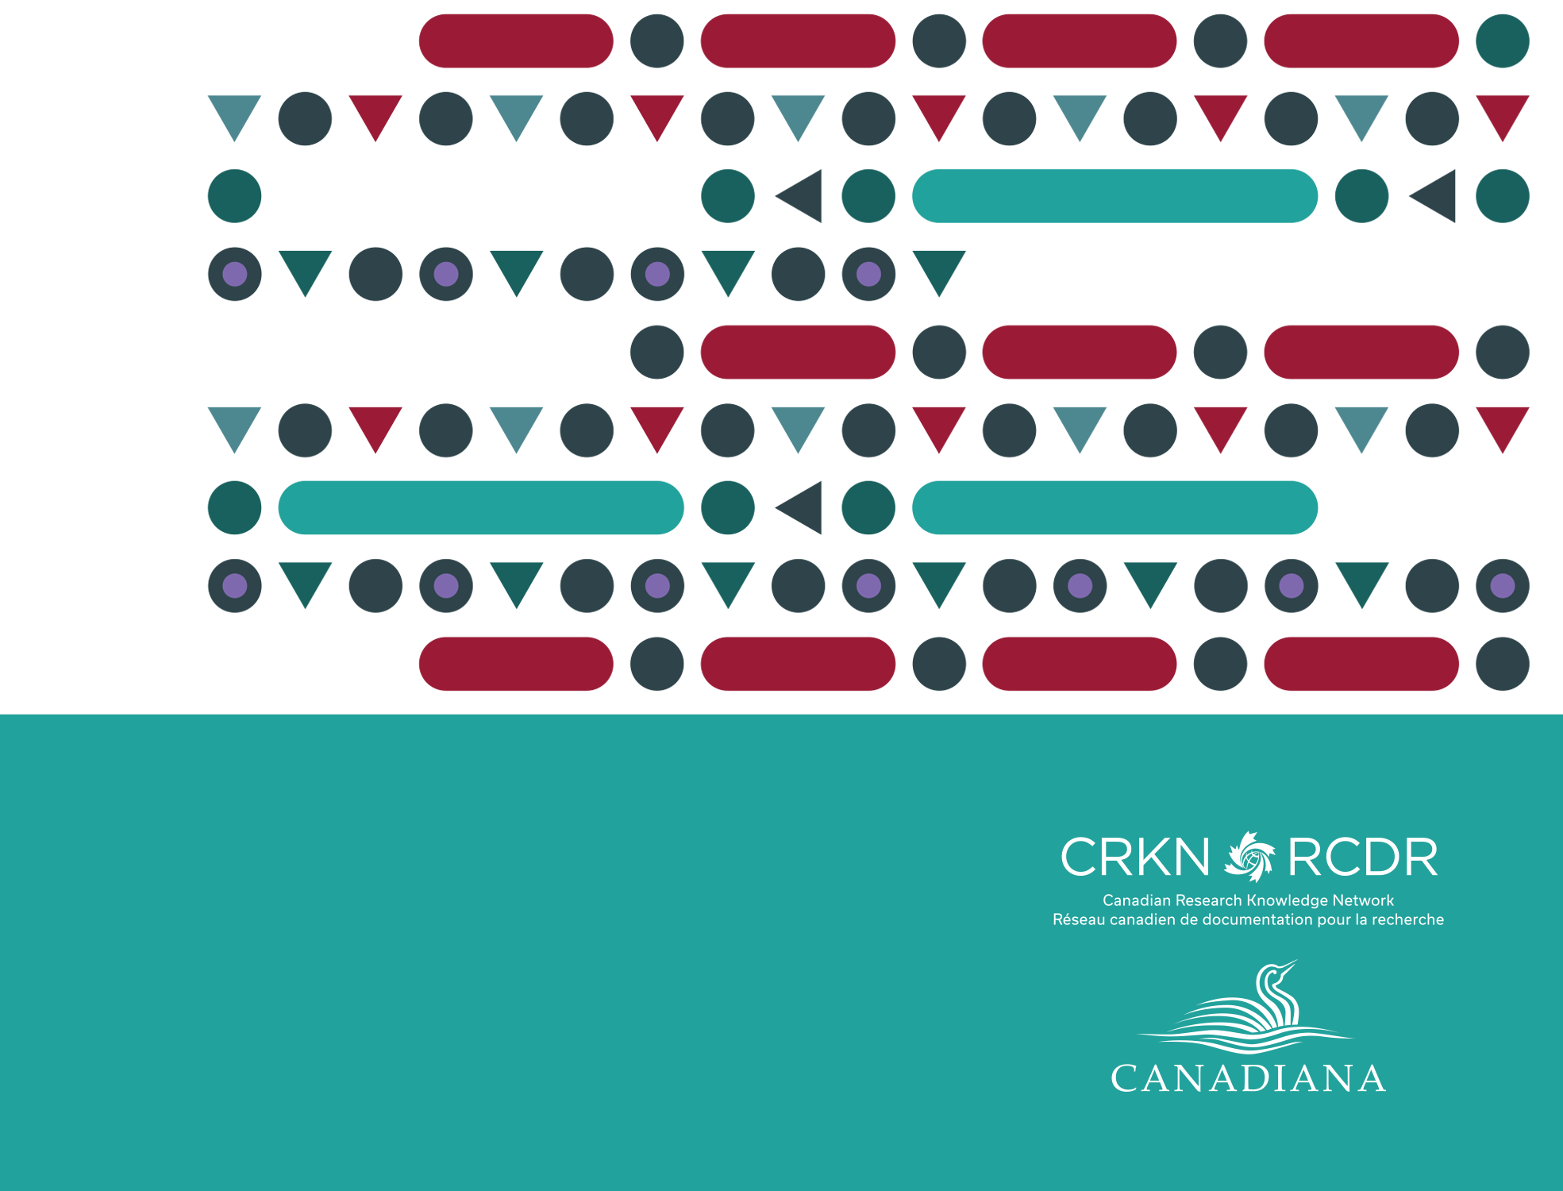
CRKN and Canadiana Update
Clare Appavoo, Executive Director, CRKN

Slide 2
CRKN & Canadiana
The Canadian Research Knowledge Network (CRKN) is a partnership of Canadian universities, dedicated to expanding digital content for the academic research and teaching enterprise in Canada.
Areas of focus:
Expanding access through licensing commercially published research content
Supporting open access initiatives
Supporting best practices in collection strategy
Supporting digital research infrastructure
History & Context
Notes:
Brief overview of CRKN
CRKN is a partnership of 75 Canadian universities, dedicated to expanding digital content for the academic research and teaching enterprise in Canada.
On behalf of our members, we undertake large scale content acquisition and licensing activities. We negotiate and manage over 50 licenses with Canadian and international publishers to provide essential research and teaching content in Canada’s universities.
In addition to licensing, we also provide a number of tools and services that are designed in consultation with members with a focus on:
Sustainable scholarly communication
Open access initiatives
Evidence-based collection management
Digital research infrastructure

Slide 3
CRKN & Canadiana
Canadiana.org began in 1978 as the Canadian Institute for Historical Microreproductions (CIHM). Canadiana preserves Canada’s heritage, making it accessible for future generations through digitization, access, and preservation.
Canadiana Collections
  Early Canadiana Online
  Héritage
  Canadiana Online
Canadiana Trustworthy Digital Repository (TDR)
Full RDA cataloguing for materials added to Canadiana Online collection plus types of metadata imported into the repository:
  MARC records
  Dublin Core metadata
  Issue Information
History & Context
Notes:
Canadiana has been preserving Canada’s documentary heritage for over 40 years. Working with partners and stakeholders, Canadiana digitizes, preserves and makes accessible its own collections and it also provides digitization, access and preservation expertise and services to institutions and organizations in Canada.
Canadiana has digitized over 70 million pages.
Canadiana Online (2018- )
Héritage (2013- )
Early Canadiana Online (1999-2017)
Canadiana also has one of only six certified Trustworthy Digital Repositories

Slide 4
CRKN and Canadiana.org merge as combined organization
On April 3, 2018, CRKN and Canadiana.org announced a merger of the two organizations, which are now under the leadership of CRKN.
Notes:
As many of you know, in April of this year, CRKN and Canadiana.org merged as a combined organization. This was the conclusion of over two years of discovery, discussion, and planning.

Slide 5
CRKN & Canadiana
Vision:
A combined organization would enable our collective community to do more together than we could achieve apart.
Leveraging shared resources:
Work toward shared goals
Leverage the TDR to support members
Advance open access
Shared membership:
22 institutions that were members of both CRKN and Canadiana
53 CRKN members subscribing to ECO
Today
Notes:
As a combined organization, we have the opportunity to work collectively toward shared goals of digitization, preservation and access to our digital documentary heritage. There is also the opportunity to leverage Canadiana’s TDR to support CRKN’s members and to advance open access and expand access to digital collections.
CRKN and Canadiana also had a overlapping membership - as a combined organization, we can develop programs and services to meet the needs of our members and our expanded stakeholder community.
Through the combination, a number of efficiencies and economies of scale have been realized – making us more available to respond to shifting and developing member and community needs.
Opportunities to centralize administration and governance
Ability to develop cross-functional teams to meet the needs of members

Slide 6
Announcing access to Canadiana collections at no charge to users
As of January 1, 2019, 60 million pages of Canadian digital documentary heritage will be available at no charge to users.
Funded by CRKN members
Members re-directing former Canadiana membership and subscription fees towards a Heritage Content Access and Preservation fund for the next three years to fund ongoing platform and collection development.
Notes:
As of January 1, 2019, 60 million pages of Canadian digital documentary heritage will be available at no charge to users.
The Canadiana Online Terms of Service will also be updated to reflect this and we will be working with the Preservation and Access Committee to determine rights statements for the content.
The removal of the subscription paywall and user fee does not mean that there are no longer costs associated with the continued maintenance and development of this content.
Ongoing costs and support for Canadiana collections comes from CRKN members who have made a three-year commitment to fund the development of the collections and access platform.
In the coming year, CRKN is looking to make critical updates to its platform, increasing the ability to find and use Canadiana content. CRKN also plans to eventually make the Canadiana collections available as open access which would entail a review and implementation of user rights statements.
These developments will once again increase ease of use and access to the collections, eventually making them more readily available in research settings and to the general public.

Slide 7
Platform Goals
Separate the preservation and access platforms to enable:
  Descriptive metadata updates and image re-sequencing independent of preservation
  Preservation independent of expectation of access
  The maintenance of separate preservation and access copies of images
Adoption of IIIF (International Image Interoperability Framework) standards
Develop APIs for image viewing, document and collection presentation, and search
Replace in-house custom components with widely-adopted external solutions (e.g., Archivematica, OpenStack Swift)
Notes:
SASCHA

