Slide 1
Untangled Web: A New Approach to Managing Ontario Government Websites
Ryan Carpenter
Government Information Day November 30, 2018

Slide 2
Overview
Why Websites?
Brief History of Websites at the Archives of Ontario
The Path Forward
Web Content Mapping
Evolving Approach
Recent Success – 2018 Election Transition

Slide 3
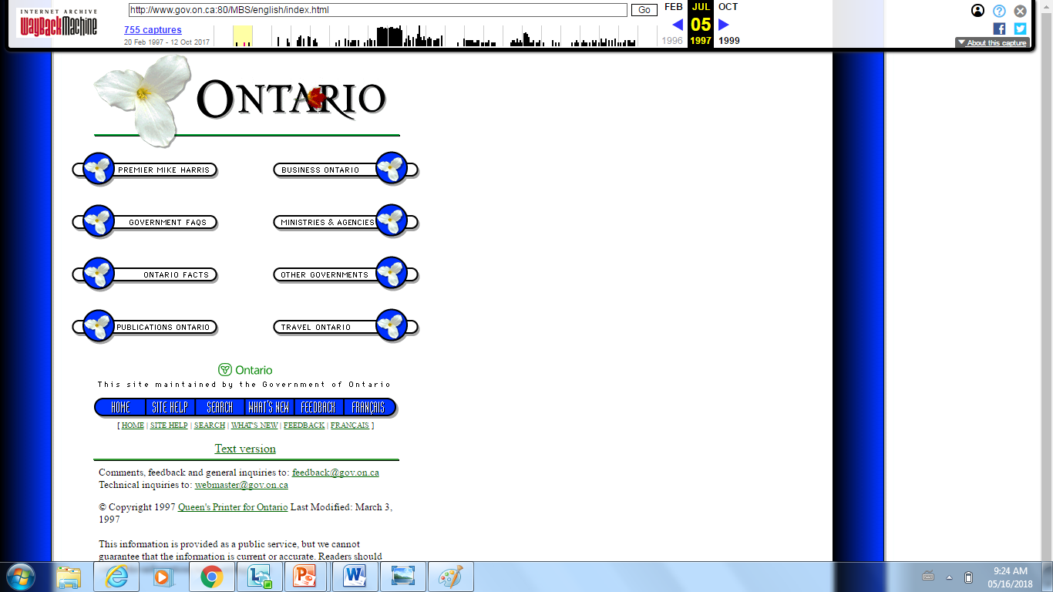
Why Websites? Then… (1997)

Slide 4
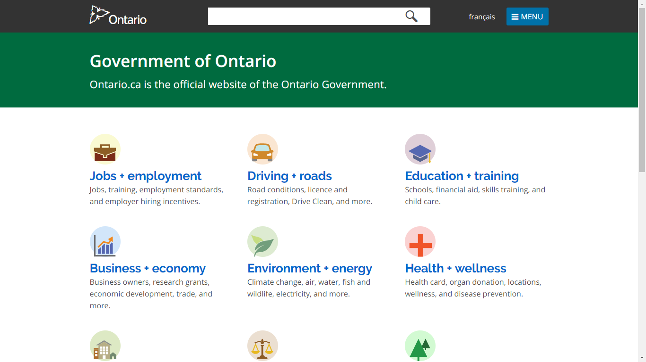
And Now (2018)

Slide 5
Brief History of Websites at AO
Archives of Ontario has history of acquiring unscheduled government websites, preserving and making available.
Transferred via removable media in HTML file format, effectively producing a static snapshot of what the website looked like at a fixed moment in time.
To date, the AO provides public access to the following Inquiry websites:
Inquiry Into Pediatric Forensic Pathology in Ontario;
The SARS Commission;
The Ipperwash Inquiry; and
The Walkerton Inquiry.

Slide 6
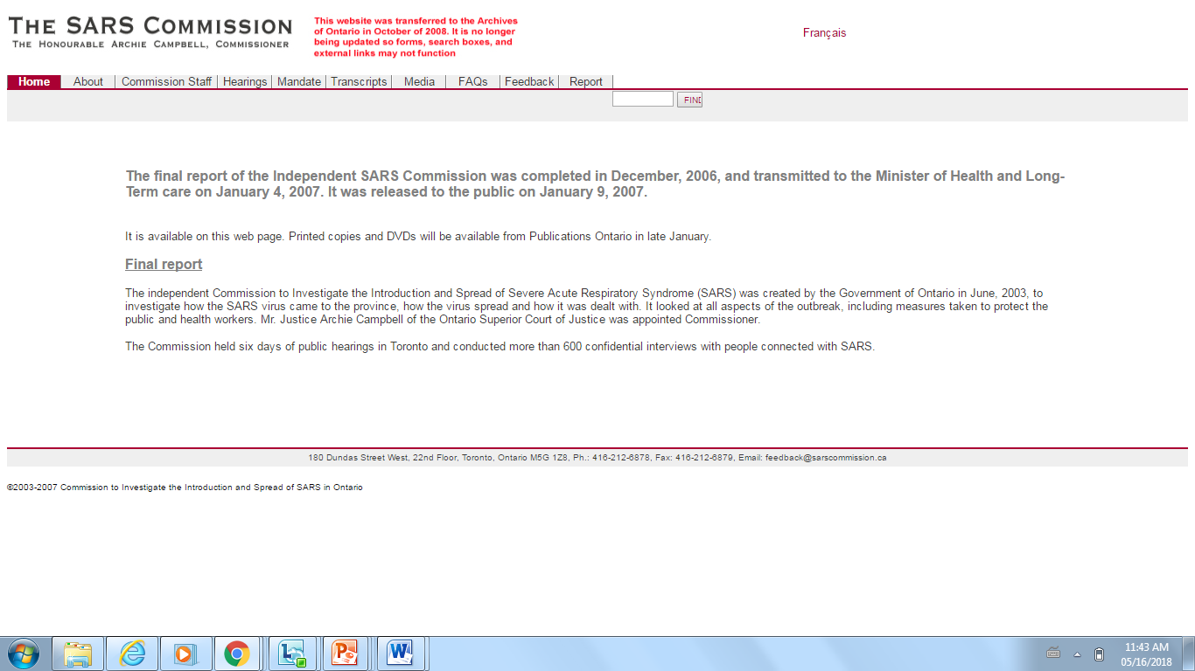
SARS Commission Website (‘07)

Slide 7
The Path Forward
Government of Ontario websites considered to be public records as defined by the Archives and Recordkeeping Act, 2006 (ARA) and business records as defined by the Corporate Policy on Recordkeeping.
Flexible and adaptable approach to identifying websites of archival value.
Less a question of “which” websites, more a question of “when” websites
Event-based (e.g. new government, new ministry or new minister; website decommissioning, special events, periodic)
Acceptance of potential duplication of content
Opportunity for collaboration with other institutions

Slide 8
Web Content Mapping
Deliver a common understanding of what it means for content to be web-based (i.e. online) in the Government of Ontario.
Provide an in-depth review of website-related activities.
Findings:
Multiple actors / platforms / software involved
Tools and templates in lieu of policies and procedures
500+ public websites (including ministries and agencies)
Others currently archiving Government of Ontario websites

Slide 9
Evolving Approach
Use findings from Web content mapping report to inform future approach to the management of Government of Ontario websites
Examine how recordkeeping can support archival activities
Guidance on website recordkeeping and archival requirements
Use of common series to manage websites
Identify which websites have long-term value
Test acquisition, management and preservation software specifically related to websites as archival records
Explore access framework (short and long-term)
Continue knowledge sharing

Slide 10
Recent Success – 2018 Election Transition
Ongoing effort during election periods to acquire copies of ministry websites if there is a change in government
Acquired copies of entire Ontario.ca and ‘gov.on.ca’ domains prior to election day.
Also: E-Laws, Ontario Newsroom, Budget Talks, Red Tape Reduction, Environmental Registry, Info-Go

Slide 11
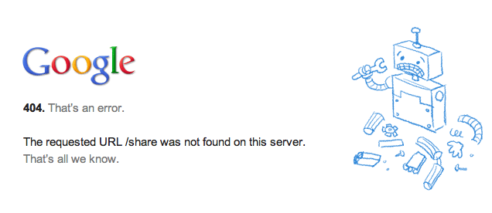
Questions and Discussion

