Slide 1
The Legislative Library Government Documents Collection and evolving technology platform
Matt Barry, University of Western Ontario Loren Fantin, OurDigitalWorld
Government Documents Info Day, November 2018
Notes:
Hi everyone.
Since 2006 OurDigitalWorld (and previously as the Our Ontario project of Knowledge Ontario) has partnered with the Ontario Legislative Library to provide a platform for online discovery of the Government Documents Collection.

Slide 2
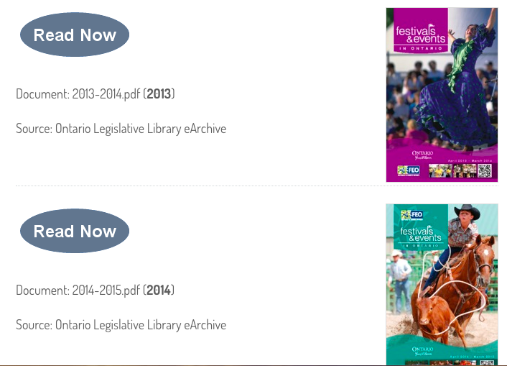
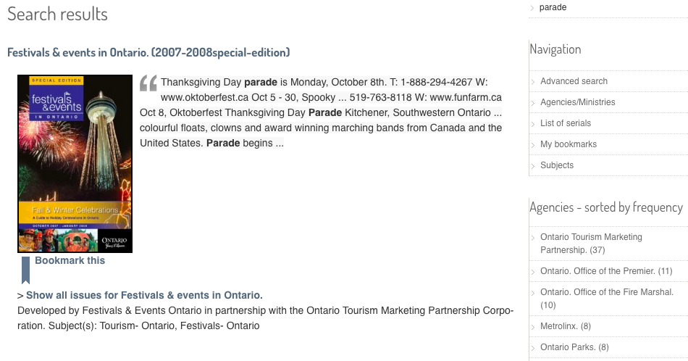
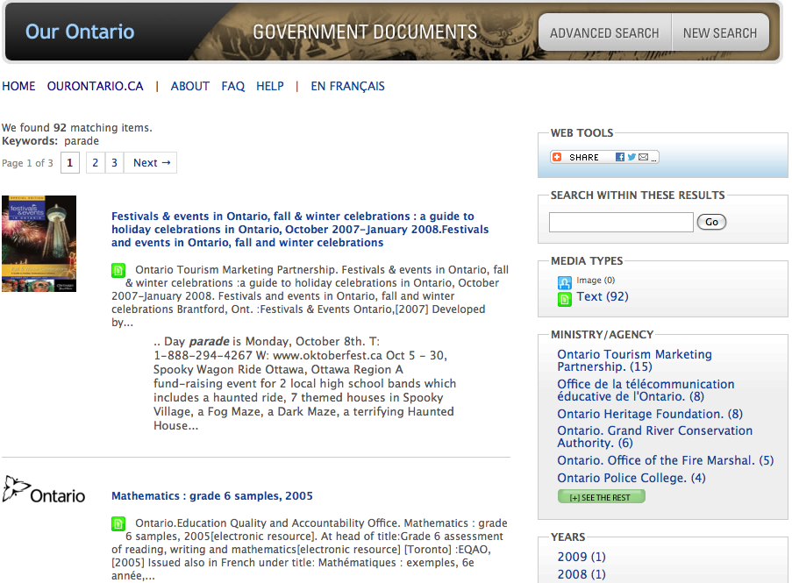
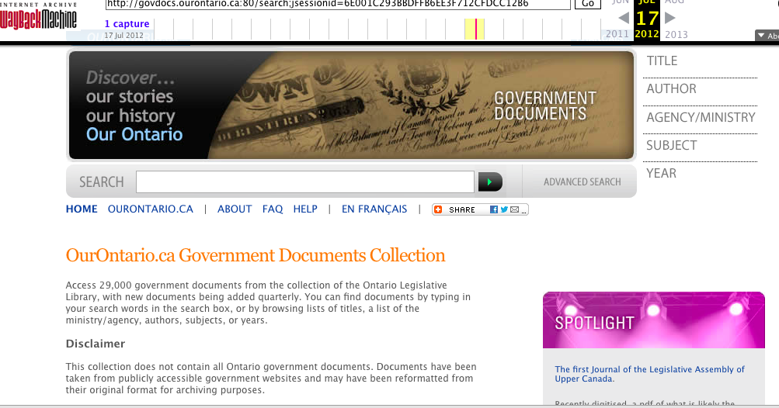
govdocs.ourontario.ca
Notes:
The Legislative Library began archiving Ontario government documents in July 2000, capturing documents from publically available websites, selected for archiving based on the Library's collection policy goal of maintaining an extensive collection that is of value to its clients and preserves the publishing output of the province for items of longer-term significance.
As part of the Ontario Digital Library initiative, later rebranded Knowledge Ontario, we were tasked with providing online access for the general public to the Legislative Library collection.
Over the years, from its first inception in 2006-2007 (I think the “public launch” was January 2008), it’s grown to provide access to about 40,000 monographs and serials, with over 2 million pages ingested for full-text indexing, with users downloading the pdfs from the Leg Lib server.

Slide 3
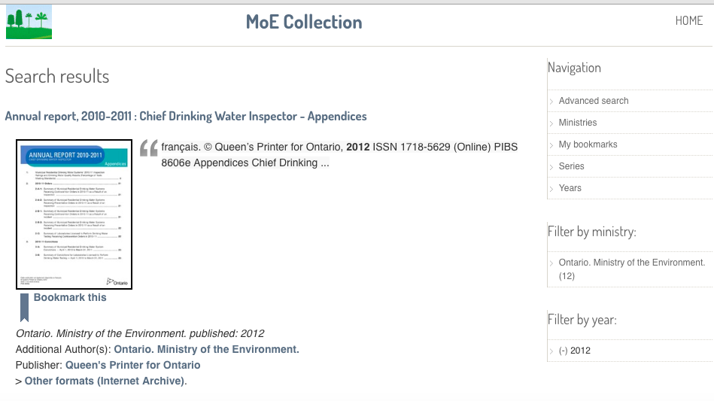
Notes:
We also worked with Ministry of Environment publications, and included links to the Internet Archive record that provides the document in alternate formats.
And here I just want to note that with the Leg Library collections - all or parts are available in other spaces, including the Legislative Library site, Internet Archive and Scholars Portal for access, or preservation, or for a particular group of stakeholders.
But ur role and our goal has always been focussed on providing a discovery layer for government documents, for the public

Slide 4
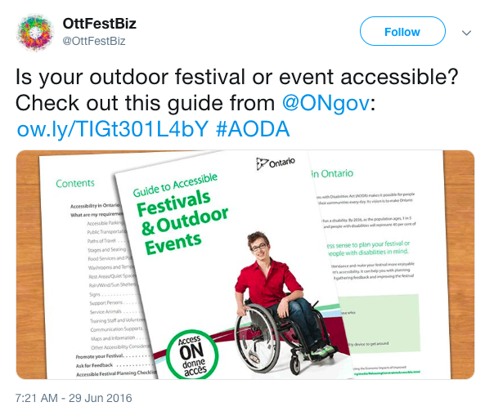
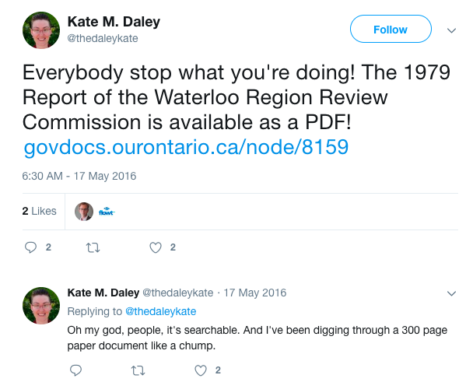
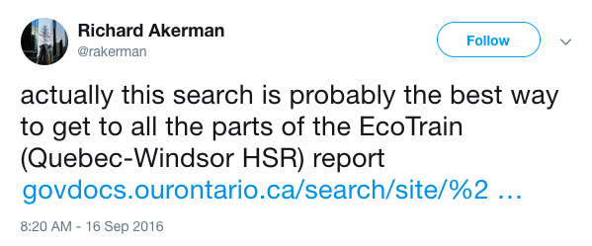
For the public
Notes:
Speaking of the public, we don’t know much about how/why and impact of making govdocs available online.
We did conduct a govdocs survey in 2014, asking for feedback on display of search results, presentation of content, use and awareness of features, access to the Hansard, and future directions, but it was mostly directed to public, academic and government librarians.
Here are some examples of use:
An organization
I love this one - from 2016 - a person realizing that the text itself is searchable...
This person is pointing to search results
This referencing the fact that
I did a google search for this title - and results point to:
1) the actual pdf
2 and 3 to the French and English metadata record available via our portal -4 to the Internet Archive, that leads you to alternate formats
5 to the record in Toronto Public Library, that points to the reference only copy they hold
point out that aggregation and reference from a more “trusted” site impacts the Google ranking

Slide 5
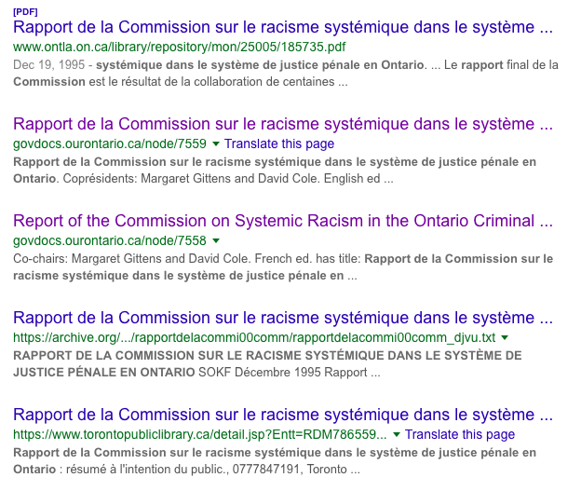
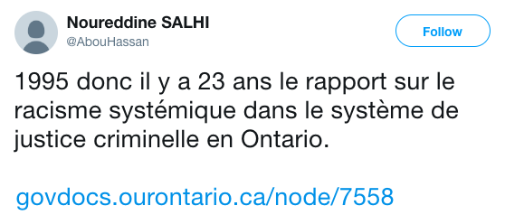
Online access for the public
Notes:
This 2018 tweet referencing the fact that it is 25 years since a report on systemic racism in Ontario
I did a google search for this title - and results point to:
1) the actual pdf
2 and 3 to the French and English metadata record available via our our govdocs portal -
4 to the Internet Archive, that also leads you to alternate formats
5 to the record in Toronto Public Library, that points to the reference only copy they hold (in physical format)
point out that aggregation and reference from a more “trusted” site impacts the Google ranking

Slide 6
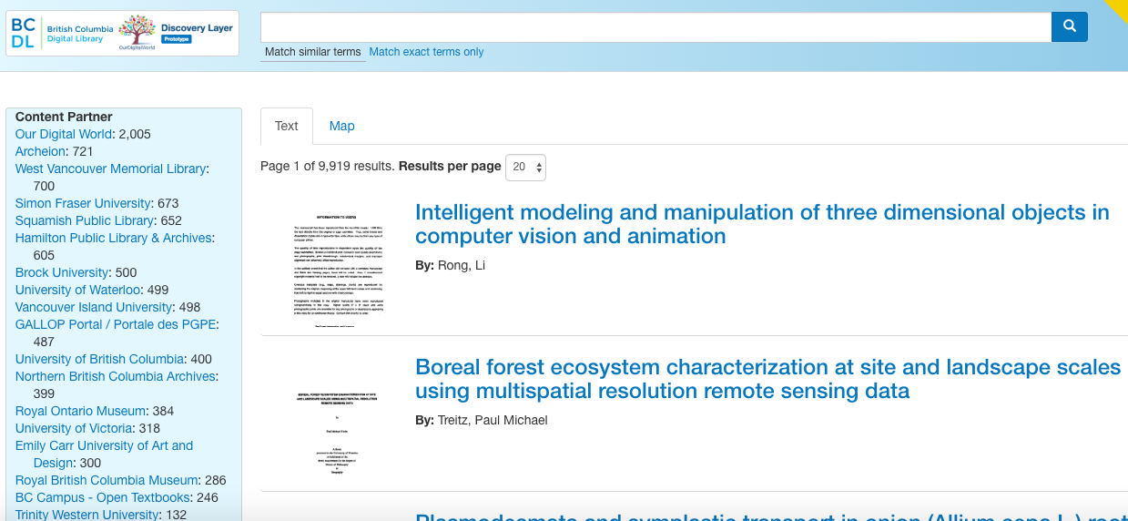
Now, the “tech” part: current Govdocs pilot
Notes:
We’re currently on our third (or more like 3.5) technology iteration, and Matt is going to talk about the current pilot, which is based on the digital library prototype we’ve piloted over the last year and a half in partnership with British Columbia.
He’ll speak to transforming the govdocs metadata, ingestion and searchability via a web discovery layer
Transformed Gov Docs metadata
Ingested with Supplejack
Made searchable via Web-based Discovery Laye

Slide 7
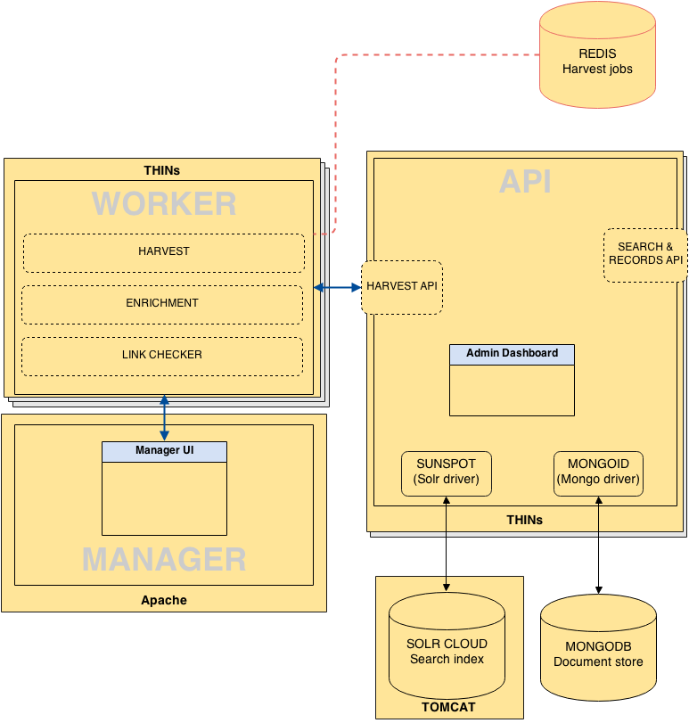
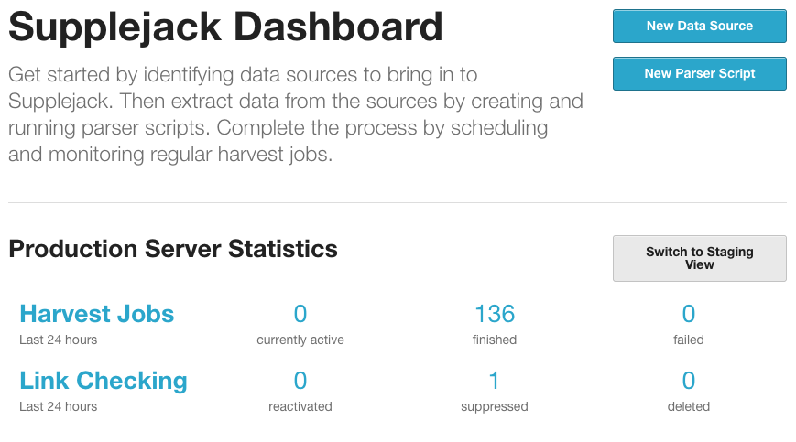
Supplejack
Notes:
What is Supplejack?
Open source metadata ingestion tool built for DigitalNZ’s national digital library. Currently also being used by Singapore’s national library, with hopes to build a South Asia / Pacific unified search.
A software stack that provides an easy interface and language for ingesting and parsing metadata from multiple sources to fit a common schema
Indexes metadata in Solr, and provides a Search and Records API to allow keyword and facet-based searching of ingested data using simple web-based requests.
Basically, it’s the entire back-end of a search engine
Why we like it
Open source means we can use it for free and modify it to fit our needs.
It actually works (many orgs like DPLA have an internally functional stack, but haven’t managed to share it in a way that’s really usable)
Separation of concerns - based on a number of separate systems that communicate via APIs, which means that it’s usually easy to find problems when things break and fix them.
Also means that we could build our on front-end interface from scratch without a huge amount of effort, giving us more control over the look and feel of the system
Means that there’s potential to integrate search into an existing institutional site, via writing a Drupal plugin or similar.
Can be used directly by machines without needing to go through the interface, which makes re-using the search data for other applications easier.
Easy to write parsers --- can ingest from many different data sources with fast turnaround times

Slide 8
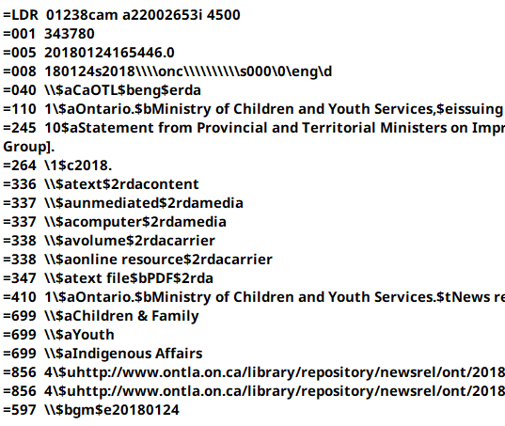
Transforming Gov Docs metadata
before
after
Notes:
Talk about process
Difficulties involved in using MARC data in a search engine
- Data we were given was in MARC, but Supplejack can only ingest XML and JSON
- Surrogates --- generally only want one title (per language), but title can be stored in a lot of different fields in MARC. Some fields don’t provide user-friendly data.
- Some records represent both English and French versions of an artifact, while others used two separate records for the separate languages
- Difficult to identify what language a given field is in without paying money to use a translation API. For our current iteration, used trial and error to figure out specific field subcodes that tended to be used for alternate language entries

Slide 9
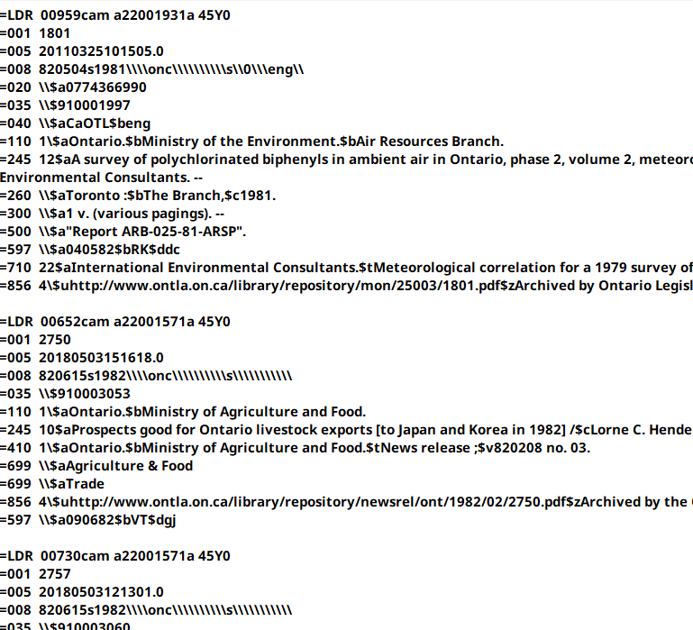
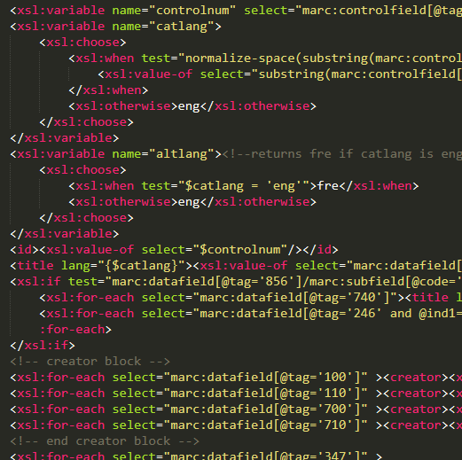
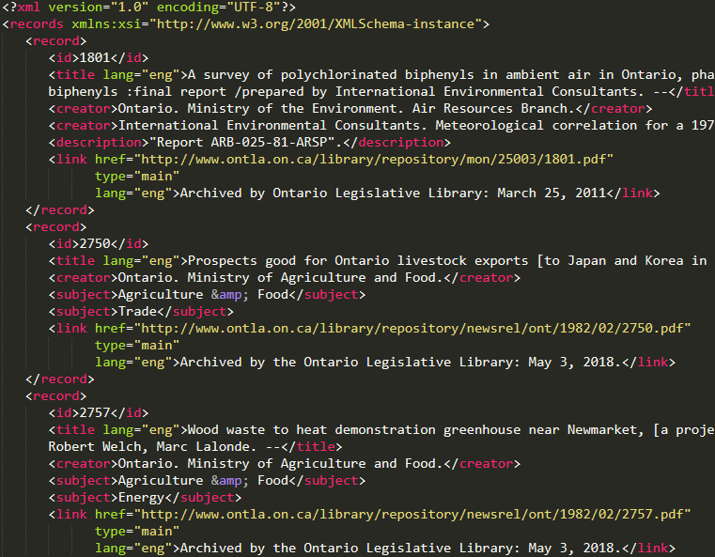
Transforming the MARC to XML via XSLT
XSLT
MARC records
XML records
Notes:
What is XSLT (Extensible Stylesheet Language Transformation)?
As mentioned before, it’s tricky converting MARC into something that looks good in a search engine---when writing the XSLT, we needed to be creative, moving data that would be relevant in our search interface---prioritising fields that would be most valuable, while falling back to other fields.
Automated transformation workflows
By using XSLT to parse the MARC into XML, we ensure that if we want to extract new fields from the original metadata down the road, it’s a simple matter of editing our XSL file, parsing the MARC file, and ingesting the output into Supplejack.
After we got the data into a format that consistently fit our schema, the next step is to ingest it into Supplejack

Slide 10
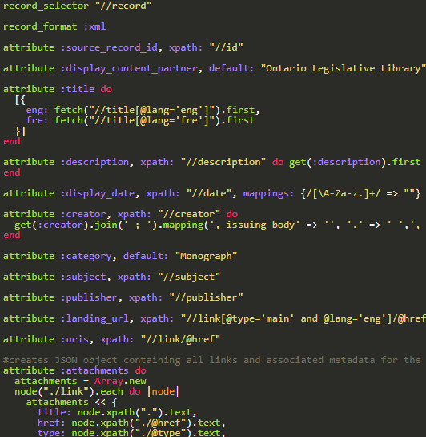
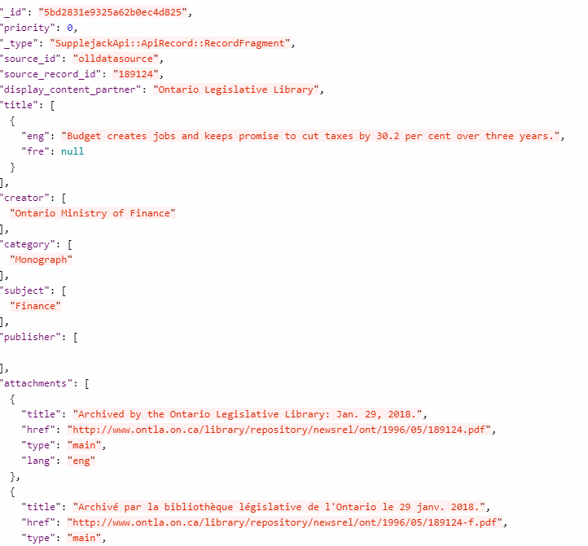
Ingesting our data with Supplejack
SJ Parser
Indexed, searchable records
XML records
Notes:
Once we have the XML file, we use a parser to ingest the data into supplejack to fit our common record schema, and then it becomes searchable!

Slide 11
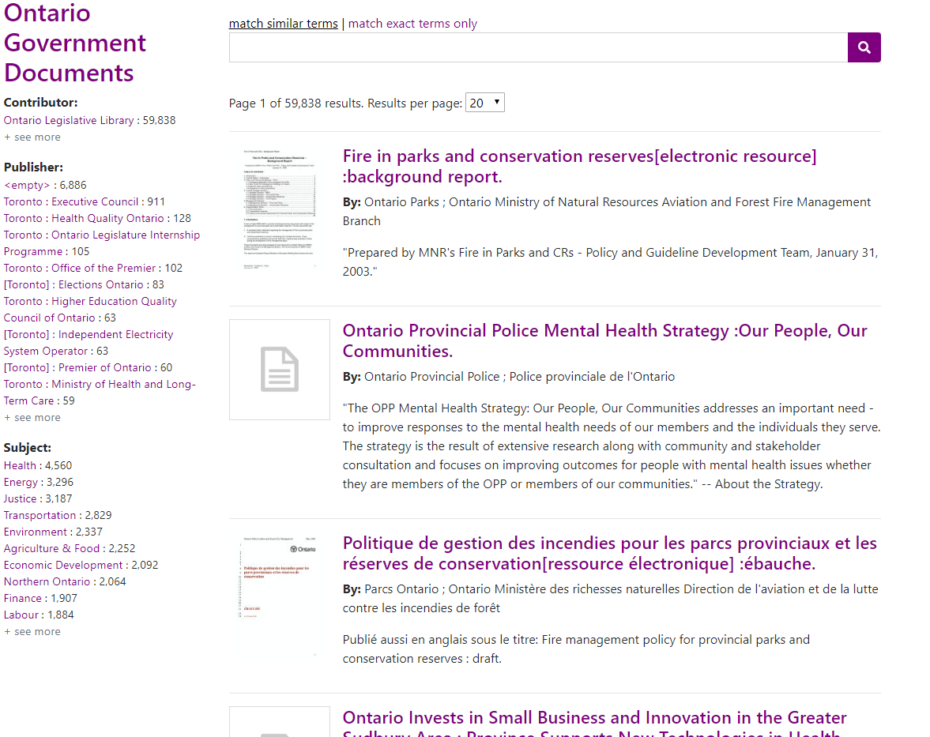
Web
Discovery
Layer
Notes:
I’m not going to spend much time on this, because we’ve all seen a search engine before.
The discovery layer we built for this can do full-text and metadata keyword searches, match similar terms, and do facet searches for any metadata field you want.
When you click on a search result, you see a result page showing more detailed metadata.

Slide 12
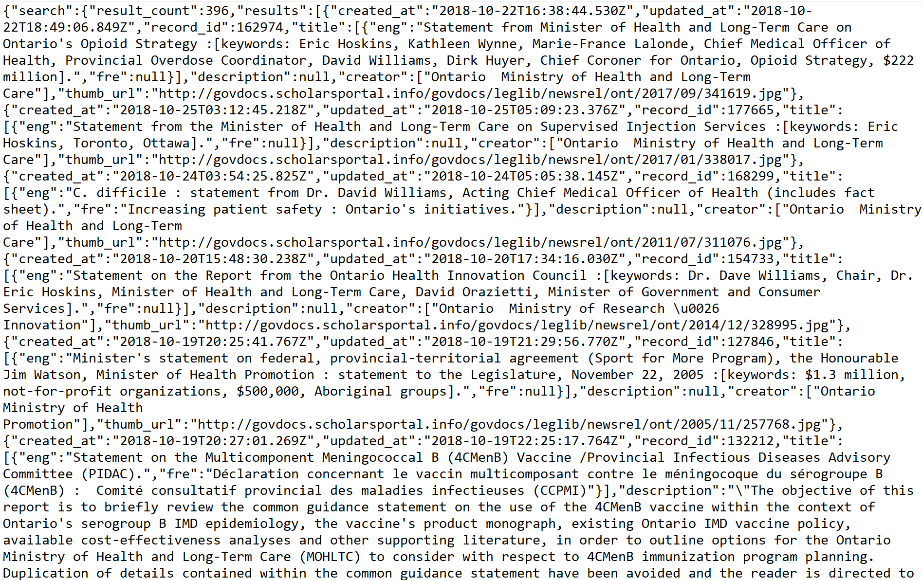
The exciting part of the discovery layer
GET
GET
Notes:
The exciting part of the interface is that all it is is a visual display of data received from requests to SJ’s Search & Records APIs.
This means that you can really do whatever you want with it, within the constraints of what the Supplejack Search API is capable of.
This means that some possibilities include number range searches, geographic bounding box searches, and more.
With control of both Supplejack and the web client interface, there’s a lot of room to customise and build things to work however you need them to.
Example: Full-text searching.
Colleague Dan Sifton (VIU) used a script to programmatically perform OCR scans on the pdf attachments for all of our records, and then store the fulltext as text files in a directory.
Our parser then has an enrichment, which is a SJ feature that allows asynchronous harvesting from more than one source, to pull all of the fulltext from each text file.
This allows our search engine to perform full-text searches on all of our PDF records.

Slide 13
Future plans
Supporting serials (Work in progress)
Aggregating government documents from additional sources into a single unified search interface
Working with the government documents community to meet emergent needs
Notes:
Serials:
In our interface, our plan with serials is to treat both the serial and each issue in it as separate records, which link dynamically to each other in the search result page. We think this will help get around the size limit for full-text documents in the data store, as well as allowing for more targeted full-text search.

Slide 14
Thank you!
mbarry23@uwo.ca
lfantin@ourdigitalworld.org
Notes:
mbarry23@uwo.ca

